Slide 1
Santiago de Chile
CLUSTERING NEIGHBORHOODS

Slide 2
ContenT
Introduction
Data acquisition and cleaning
Data Analysis
Clustering Results
Conclusions

Slide 3
INTRODUCTION
Solution
Tourists with little time visiting Santiago of Chile
Create options as recommendations…
The idea is to help tourists to take decisions in base to characteristics of group of neighborhoods of Santiago.
PROBLEM
Notes:
Considere la posibilidad de hablar acerca de:
Orígenes y fundación
Santiago colonial
Capital de la República
La ciudad del siglo XIX
El Santiago del Centenario
Explosión demográfica
El Gran Santiago
La ciudad en los inicios del siglo XXI

Slide 4
Data acquisition and cleaning
Sources
Wikipedia (Scraping)
Google Maps (API)
Foursquare (API)
Cleaning and Wrangling
Neighborhoods geographical coordinates
Venues inside neighborhoods
Grouping categories of venues
Notes:
Considere la posibilidad de hablar acerca de:
Geología y relieve
Hidrografía
Clima
Medioambiente

Slide 5
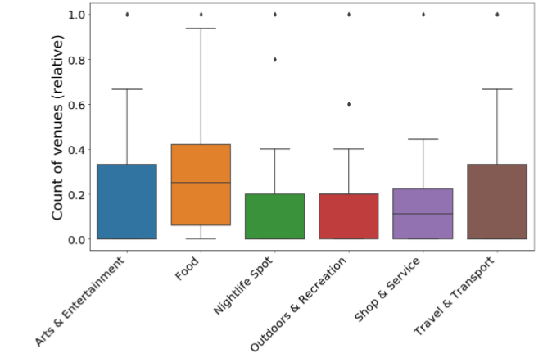
DATA ANALYSIS
Normalizad distributions of venues by categories
Box Plot
Mapping
From 10 top categories, the venues found inside neighborhoods
7 were found and 6 were used for análisis and model
Notes:
Considere la posibilidad de hablar acerca de:
Administración
Evolución histórica
Comunas del Gran Santiago
Capital de Chile
Símbolos de la ciudad

Slide 6
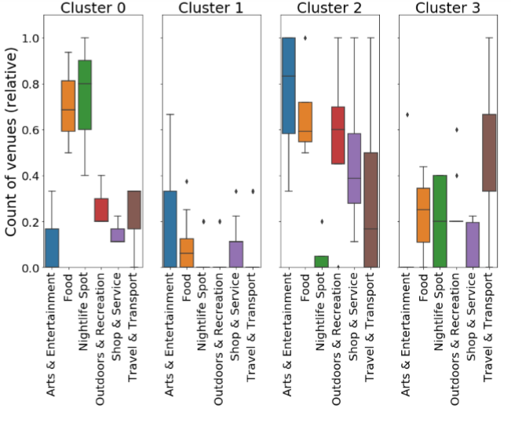
CLUSTERING Results
Notes:
Considere la posibilidad de hablar acerca de:
Distribución de la población
Religión

Slide 7
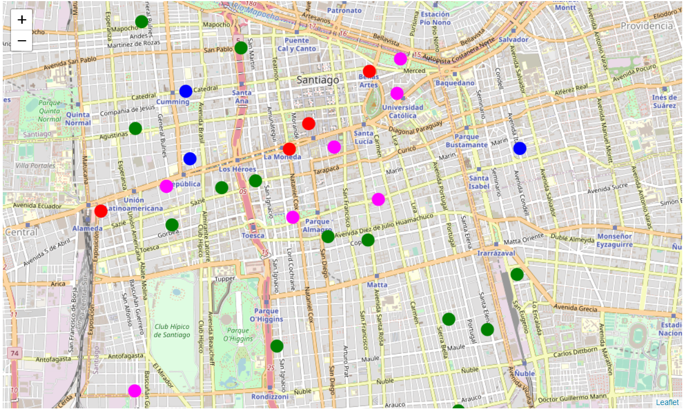
CLUSTERING Results
Blue : Neighborhoods as nice spot to go out for food and bars (nightlife).
Green: Neighborhoods with low venues, their spots (few) are most related to arts & ei, food and shop and service.
Red: Most diverse Neighborhoods, great for arts & ei, food, outdoor & recreation, shop & service and travel & transport.
Magenta: Neighborhoods with travel and transport to any point of the city, 2nd place as a nightlife spot, some food and shop & service
Notes:
Considere la posibilidad de hablar acerca de:
Distribución de la población
Religión

Slide 8
conclusions
Results make sense
Two points could change the results:
* Foursquare did not have too much success in Chile, therefore there are not enough venues assigned to each neighborhood. Anyway, as the assignment was asking to use foursquare-api and I wanted to explore my city I continue it despite possible lack of some data.
* Using the same radius space for each neighborhood do not add precision to the analysis because each neighborhood have different distribution of it. With the boundaries of each neighborhood the analysis could improve (not available).

